Slide 1
Organic Transistors
By Prasann Viswanathan
190070047

Slide 2
Outline
Device physics and parameters
Materials used in fabrication
Fabrication techniques
Current applications in industry
Future plans of work

Slide 3
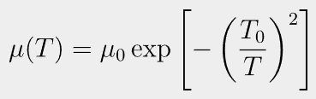

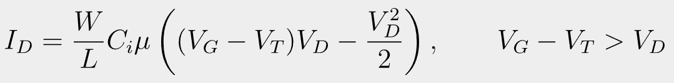
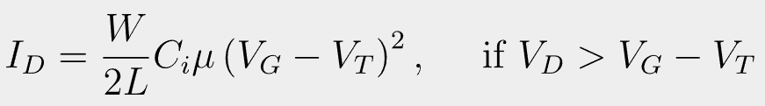
Device Physics and Parameters
Carrier Mobility
Temperature and Field dependent
I-V characteristics in different modes of operation
Linear
Saturation
On current to Off current ratio
Threshold voltage
J. Chang, Z. Lin, C. Zhang, and Y. Hao, "Organic Field-Effect Transistor: Device Physics, Materials, and Process", in Different Types of Field-Effect Transistors - Theory and Applications. London, United Kingdom: IntechOpen, 2017

Slide 4
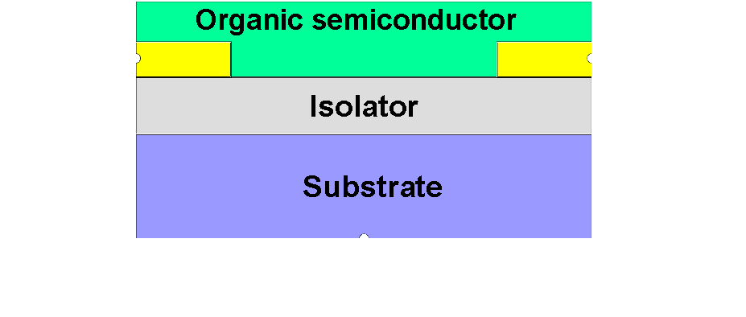
Materials
Substrate
Quartz, glass, silicon wafer. Polycarbonate, polyimide
Electrodes
Metals: Gold, palladium, magnesium, aluminium. Non-metal: graphite, 10-CSA doped polyaniline
Dielectric Layer
Ta2O5, Barium zirconate titanate (BZT)
Semiconducting Layer
Image from: Materialscientist, CC BY-SA 3.0 <https://creativecommons.org/licenses/by-sa/3.0>, via Wikimedia Commons

Slide 5
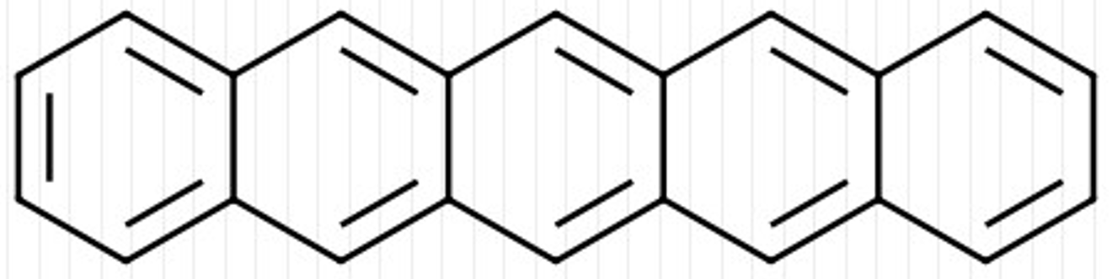
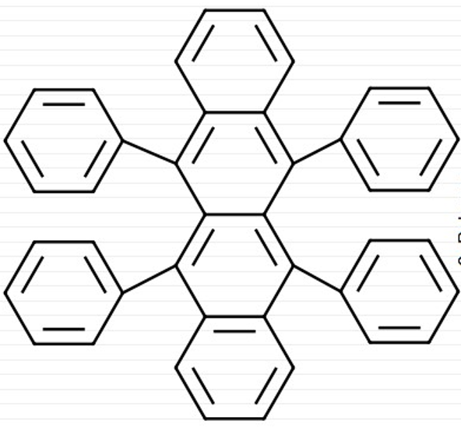
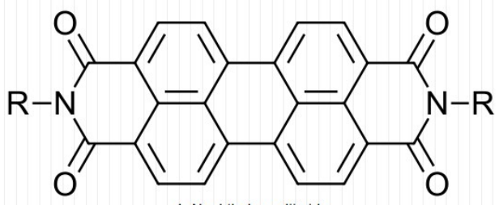
Semiconducting Layer
Different charge transport nature
P-type
Polycyclic aromatic compounds
Pentacene, rubrene
N-type
Scarcer than P-type
Lower performance and unstable in ambient conditions
Perfluoropentacene, Naphthalene-diimide with cyanides
Chandar Shekar, B., Lee, J. & Rhee, SW. Organic thin film transistors: Materials, processes and devices. Korean J. Chem. Eng. 21, 267–285 (2004).

Slide 6
Fabrication Techniques
Vacuum Evaporation
Extremely low pressures
Expensive and only for small molecules
Solution Deposition
Cost effective method
Material must be soluble or dispersible in medium

Slide 7
Continued
Thin Film Alignment
Alignment provides better mobility
Mechanical/ Growing crystals/ Field-induced/ Solution-processed/ Direct deposition
Patterning
Eliminating parasitic leakage and cross talk
Different methods

Slide 8
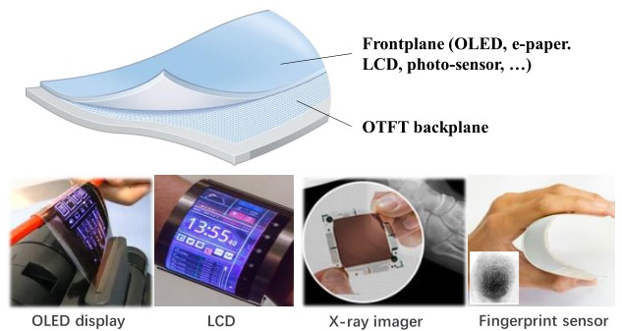
Applications in Industry
Flexible displays and e-papers
iPhone covers with flexible displays
Philips with E-Ink demonstrated 85 dpi active-matrix backplane with bend radius 2cm
Biosensors
Mainly voltage transducers
Glucose level detection, X-Ray imagery and fingerprint sensing
Simple logic circuit applications
RFID cards, smart cards and disposable sensors
Image by: X. Guo et al., ”Current Status and Opportunities of Organic Thin-Film Transistor Technologies,” in IEEE Transactions on Electron Devices, vol. 64, no. 5, pp. 1906-1921, May 2017.

Slide 9
Conclusion and Future Improvements
Lack of material stacks to produce high performance, stable and uniform Organic Transistors
Lack of standardisation of material, device integration and manufacturing methods
Trade-offs between large scale, low-cost processing and performance
Defining focused applications

Slide 10
Thank you!

